Slide 1
SNA for Assesing MENTAL HEALTH
Ioana-Gabriela Chelaru

Slide 2
Table of contents
Approaches
Introduction
The issue of mental health
The different points of view and contexes analyzed
Conclusions
Discussions
The conclusions withdrawn from both studies
Open discussions and questions

Slide 3
The issue of MENTAL HEALTH
Introduction
‘Abnormal thoughts, perceptions, emotions, behaviour and relationships with others’
Mental illness contributes about 7.1% to global disease burden
As of 2010, close to 900 million people were estimated to suffer from certain mental health issues
Poor neighbourhoods and low-income communities potentially offer more stressful environments for urban citizens.
Over a person’s lifetime, psychological disorders can adversely affect one-third of the global population.
Fragmentation in mental health care delivery systems has become a public mental health issue in many Western countries

Slide 4
Approaches
Assessing Mental Health and Social Services Inter-Organisational Collaboration
Data collected from 14 European countries: 80.000 – 150.000 individuals each, plus all mental health and social care organizations (A1, A2, B1, B2, C)
Organizations = nodes, interactions between them = links
Leutz’s levels of integration: linkage, coordination, full integration (A1)
- Level 1: degree and density measures
- Level 2: centrality measures
- Level 3: the position of fully integrated services into the network

Slide 5
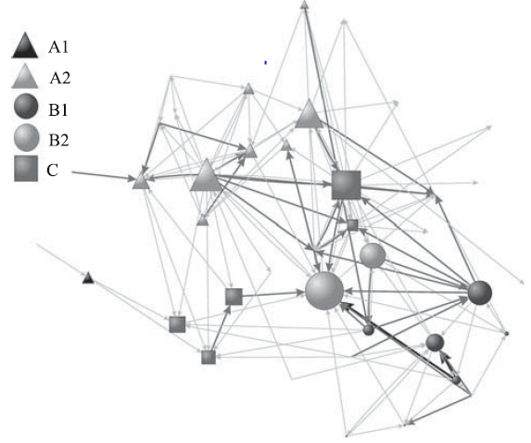
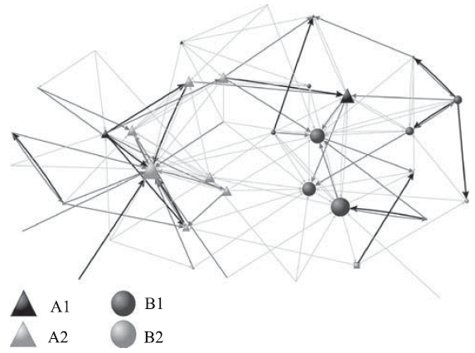
Approaches
London
Brussels

Slide 6
Approaches
Cross-sectional study based on a community census
Data collected from 824 men aged 18-29 living in an urban slum in Bangladesh
Men = nodes, friendships between them = links
Network analysis software Pajek
Assessment of the relationship between mental well-being and social ties: applied different regression models with different social network measures.

Slide 7
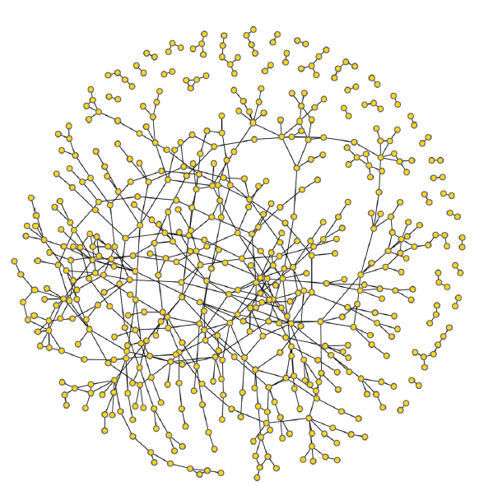
Approaches

Slide 8
Conclusions
The fragmentation between mental health and social care
services remains an important issue.
SNA indicators can contribute to the assessment of the integration of care at the system level.
The importance of social relations in determining mental well-being in resource-constrained contexts.
In general, urban areas and youth populations are prone to isolation and can suffer from psychological distresses and psychoses.

Slide 9
Do you have any questions?

